Slide 1
String Class in Java

Slide 2
What is String Class ?
String is a sequence of characters. In java, objects of String are immutable which means a constant and cannot be changed once created.
Extends “Object” class .
String class includes methods for examining individual characters of the sequence ,for comparing string , for searching string ,for extracting substring and for creating a copy of a string with all characters translated to uppercase or to lowercase.
Java provides special support for string concatenation ( + ) and for conversion of other objects to string .

Slide 3
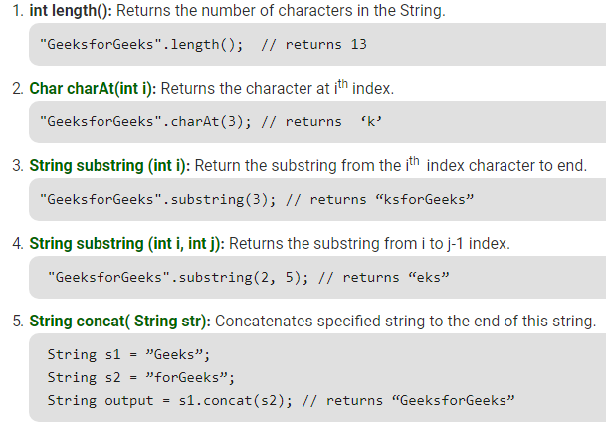
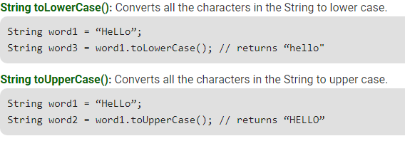
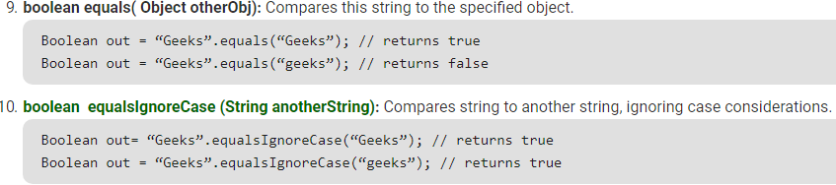
String Methods -

Slide 4
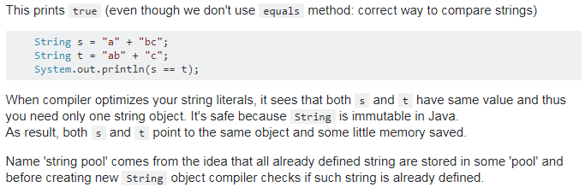
What is String pool ?
The string pool is JVM’s particular implementation of the concept of String Interning.

Slide 5
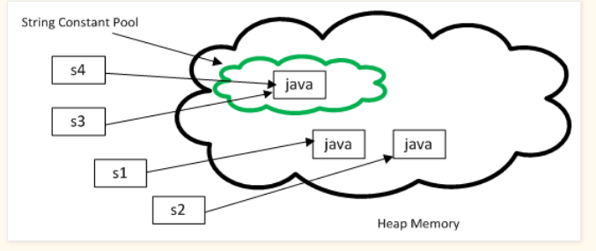

Slide 6
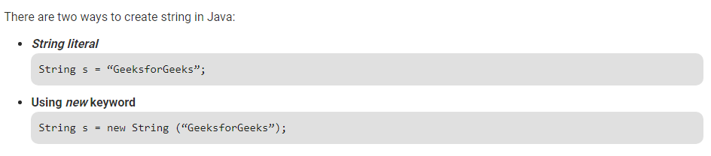
Creation of string with and without “new” keyword
When we create a String object with “new” keyword it always creates a new object in the “heap memory”
When we use String literal , then it checks for any same existing String object , and sends it back, if , found or else, creates a new object.

Slide 7
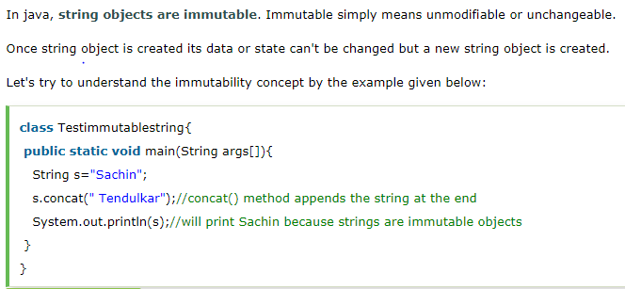
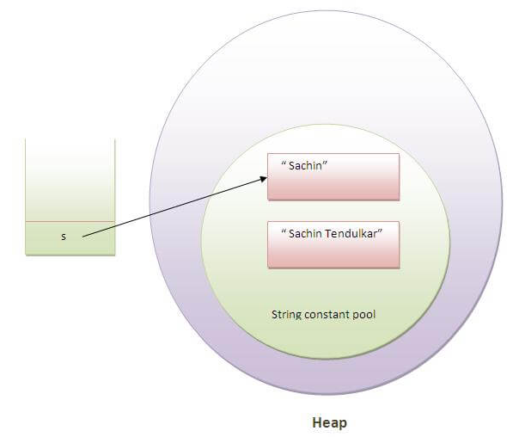
What is String immutability ?

Slide 8
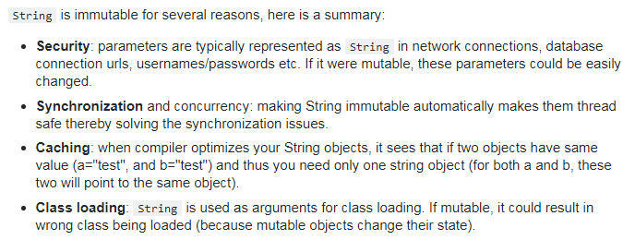
Why String is immutable ?

Slide 9


StringBuffer class
StringBuffer is a peer class of String that provides much of the functionality of strings. String represents fixed-length, immutable character sequences while StringBuffer represents growable and writable character sequences.
StringBuffer may have characters and substrings inserted in the middle or appended to the end. It will automatically grow to make room for such additions and often has more characters preallocated than are actually needed, to allow room for growth.
StringBuffer Constructors -
StringBuffer( ): It reserves room for 16 characters without reallocation.
StringBuffer( int size)It accepts an integer argument that explicitly sets the size of the buffer.
StringBuffer(String str): It accepts a String argument that sets the initial contents of the StringBuffer object and reserves room for 16 more characters without reallocation.

Slide 10
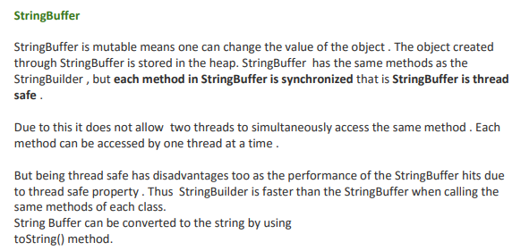
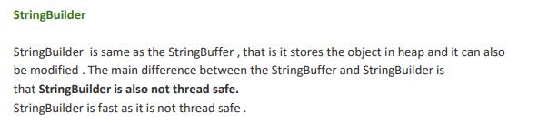
Difference between StringBuffer and StringBuilder -

Slide 11
Thank You.
How’s the Josh ?

